Slide 1
The Great Depression and Bretton Woods: Economic Lessons and Solutions

Slide 2
Overview
Polanyi’s analysis economic history and political economy
Western Economy Timeline
Key Concepts

Slide 3
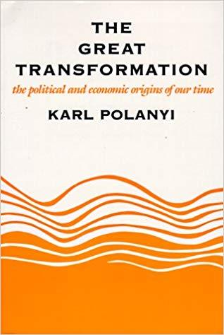
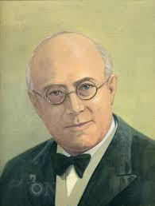
The Great Transformation: The Political and Economic Origins of Our Time by Karl Polanyi
First published in 1944 towards the end of WWII
Analysis of eighteenth, nineteenth and early twentieth century economic history and political economy
Thesis asserts that the concept of the self-regulating market is a utopian dream

Slide 4
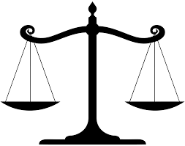
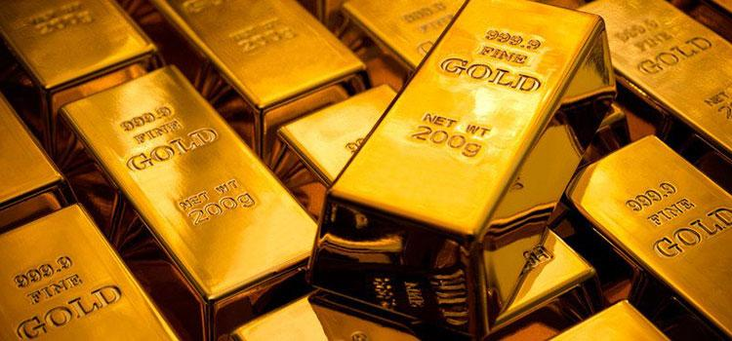
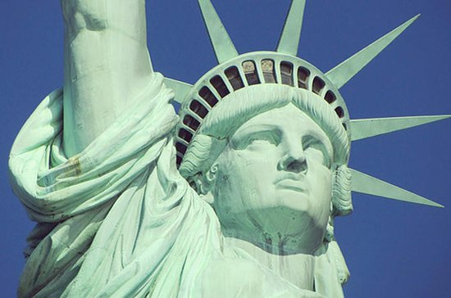
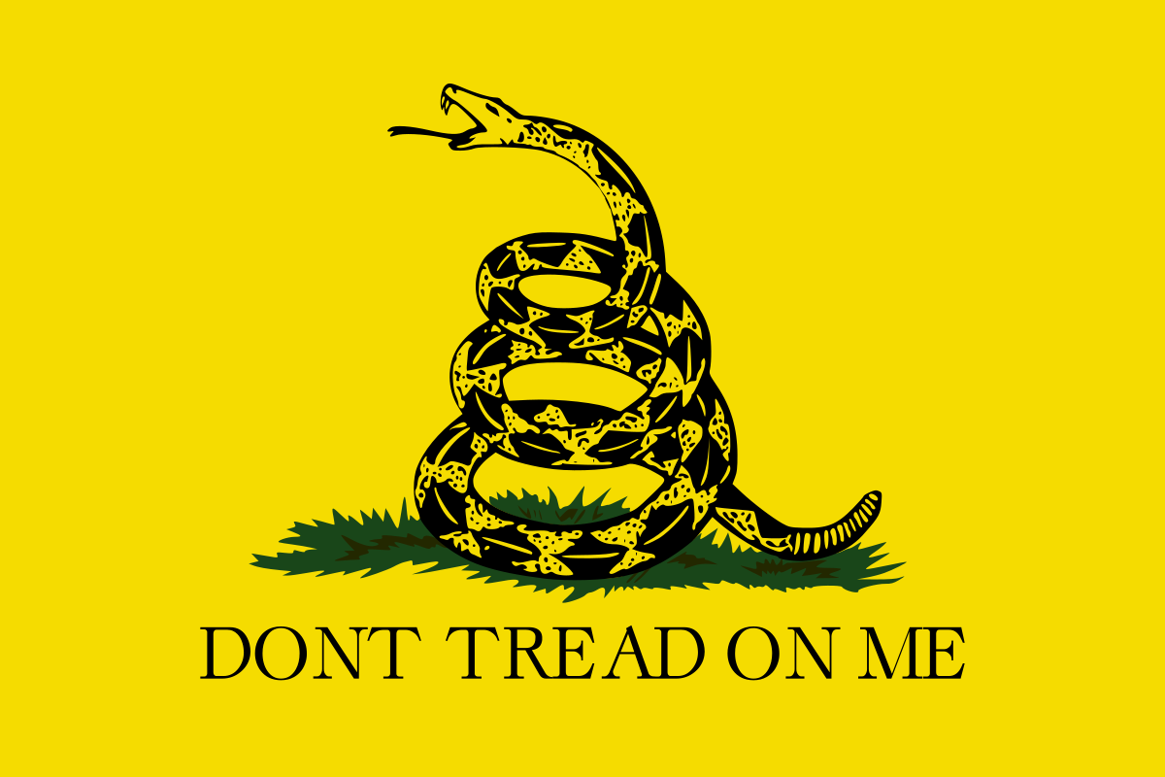
Collapse of 19th Century Institutions
Begins book by asserting that “nineteenth century civilization has collapsed” (p.3)
Nineteenth century was upheld by four primary institutions, 100 years peace between the Great Powers
Gold standard cause of the collapse
Balance-of-powers
The Gold Standard
The Liberal State
Self-Regulating Market

Slide 5
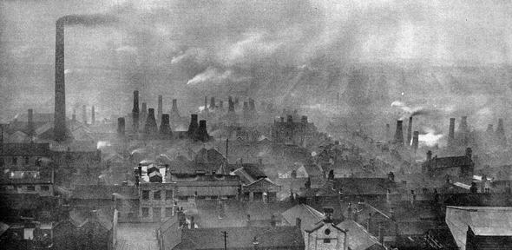



Origins of the Crisis
Origins of the crisis from Industrial Revolution in England
Emergence of the self-regulating market institutionally separated society into economic and political spheres

Slide 6
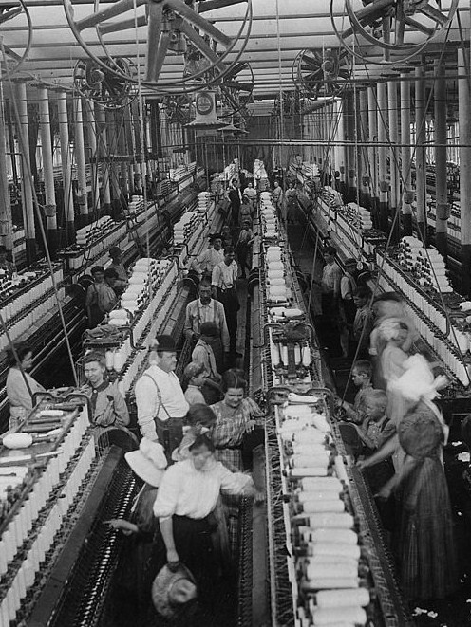
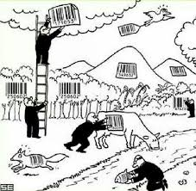
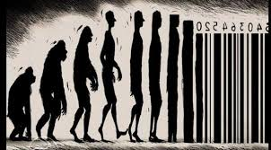
Consequences of the Self-Regulating Market
Commodification of labour, land and money
No matter the social and environmental cost, economic liberalism became the priority
Paradoxically government often became an administrative organ for economic liberalism

Slide 7
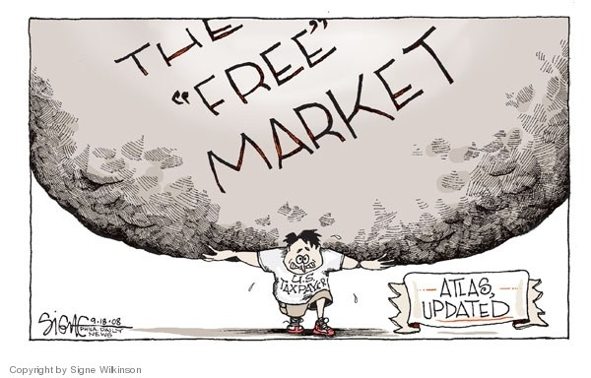

Slide 8

The Counter-Movement of the 1870s & 80s
Attempted to remediate through regulation:
poor health and labour standards,
strengthen workers rights and
put in place economic tariffs

Slide 9
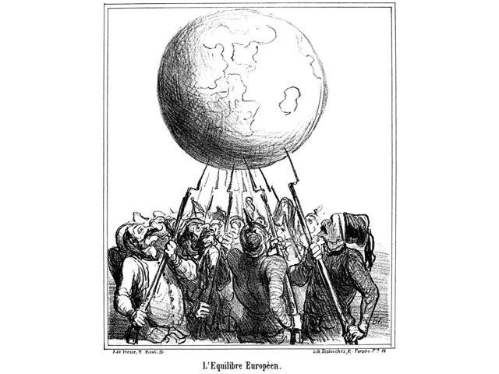
Precarious World System & the Beginning of the Collapse
upheld by Balance-of-Powers and
International finance (Trade)
However, end of the 19th and beginning of the 20th century saw the Great Powers unify into to antagonistic forces
Brought an end to the Balance-of-Powers and 19th century international economic organization and led to WWI

Slide 10

Post-WWI and the Deepening of the Global Crisis
Same “political and economic impediments to peace” were continued after the Great War
Disarming of Germany (post-war Treaties)
The monetary policies (gold standard)

Slide 11
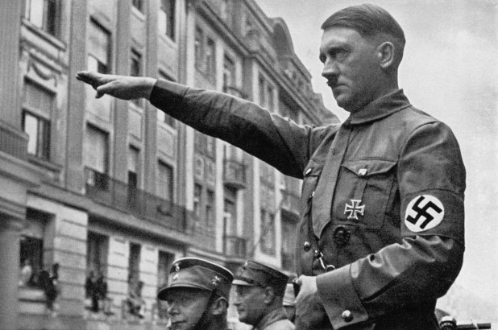
Total Collapse of the 1930s, the Rise of Fascism and WWI
National Institutions crumbled -many liberal states were replaced by totalitarian dictatorships -free markets were replaced with other economic models
Caused by the economic liberalism of the self-regulating market
Rise of Fascism and onset of WWII

Slide 12
“With the liberal the idea of freedom thus degenerates into a mere advocacy of free enterprise—which is today reduced to a fiction by the hard reality of giant trusts and princely monopolies… Yet the victory of fascism was made practically unavoidable by the liberals’ obstruction of any reform involving planning, regulation or control.” -Karl Polanyi, The Great Transformation: The Political and Economic Origins of Our Time (p.257)

Slide 13
Polanyi’s Suggestions
Decommodification of labour, land and money
Polanyi advocates for the “economic collaboration of governments and the liberty to organize national life at will.” (p.254)
Governments should engage in redistributive measures which can be achieved without sacrificing individual rights

Slide 14
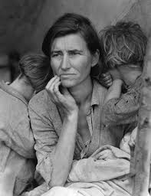
Timeline of the Depression
1919: Treaty of Versailles
1921-1923: Inflation in Europe
1920s: Era of Gold
1928: Credit drought and Wall Street Crash
1930-1938: Depths of the depression
1938-1939: Recovery on the Road to War

Slide 15
Timeline: Bretton Woods to Today
1944: Bretton Woods, New Hampshire- The Birthplace of the modern international order
1944-1971: Bretton Woods Monetary Order
1980s-2000s: Capital/Economic Liberalization in US and Europe
2000s: Great Days for the World Economy
2008: Financial Crash
2010s: Declining US?

Slide 16
Key Concepts
Gold Standard System
(Lack of) International Cooperation
Changing Global Order
Political results of the Depression
Bretton Woods Institutions and Monetary Order
Economic Liberalization and Deregulation
Ideas in Economics

Slide 17
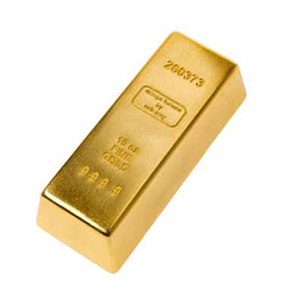
Gold Standard
Gold Backed currencies the norm until now
Gold provided distinct advantages in exchange stability
Also a point of pride for nations
Had significant drawbacks during the Depression
Politicians poorly understood the gold system
Discouraged international financial cooperation

Slide 18
International Cooperation
International cooperation vital but nonexistent 1923-1938
Could have solved many problems of the depression
US could have made big difference but was reluctant to get involved in international economy
Bretton Woods looked to make International cooperation the norm

Slide 19
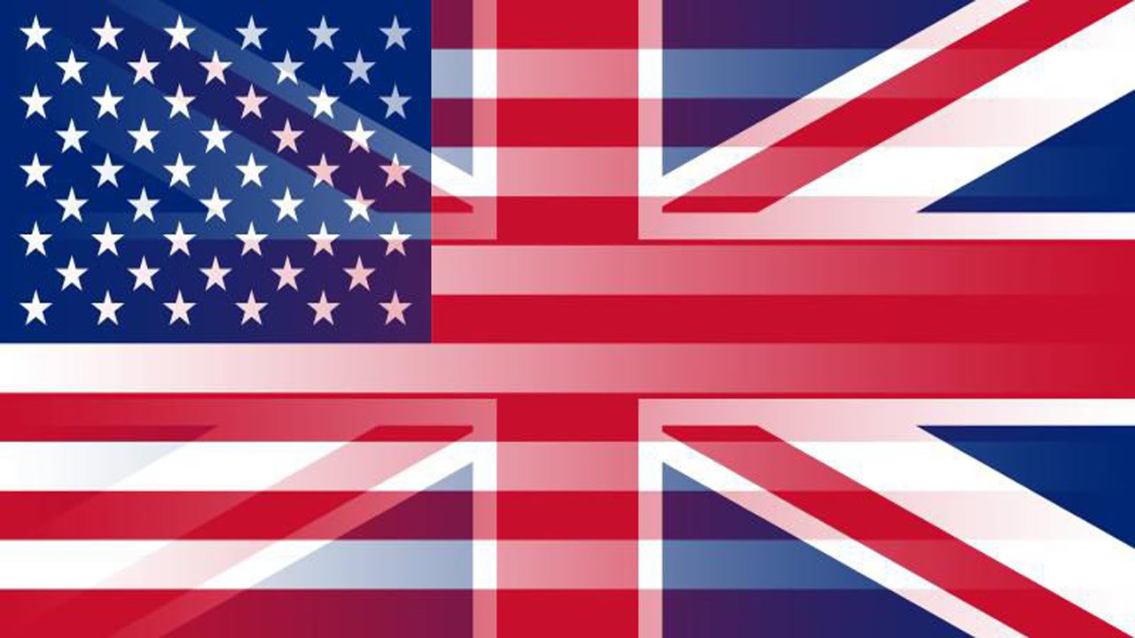
Changing Global Order
Europe was hit hard by the First World War
UK lost hegemony and US became unwilling hegemon
US did not want to help → No one else could
Only after WW2 did US accept the costs and responsibilities of hegemony

Slide 20
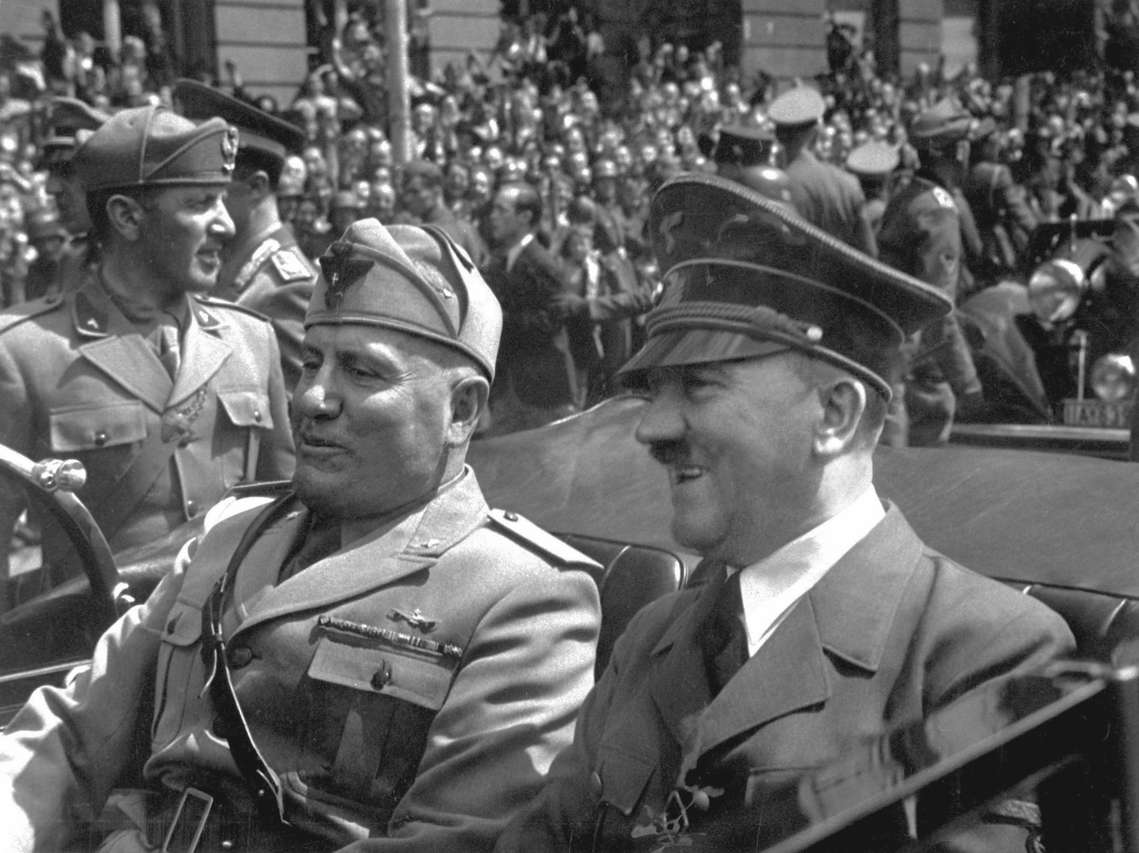
Political Outcomes
Society was hit hard by depression
Unemployment and poor safety net led many into destitution
In Italy, Spain, Germany, Poland, and France, politics shifted right, sometimes to fascism

Slide 21
Bretton Woods Institutions and Monetary Order
Meeting in 1944
US went back to gold, with allies pegging their currency to USD
Led to IMF, World Bank, GATT→ WTO
US in best position to provide an international currency
Strength in:
Military
Economy
Politics

Slide 22
Economic Liberalization and Deregulation
Post-Bretton Woods = rulemaking and cooperation
In 1980s, Reagan and Thatcher embodied trade liberalization and deregulation
Big Government
Lessons of the past forgotten
Led to the bubble in late 1990s and eventual 2008 crisis
Deregulation + Increasingly Complex Economics= Recipe for Disaster

Slide 23
Power of Ideas in Economics
Financial systems are built on human understanding and acceptance
Money is only given value because we commonly accept it
Crises like the Great Depression and 2008 happened because of fearful beliefs
Gold Standard = Misery
Bretton Woods rules and institutions for increased stability
Stability+Certainty= Good Business

Slide 24
Questions of the week
Why did the global order collapse in the 1930s?
Bretton Wood Order in 1944-1945: why was it done in that way?

